Slide 1

Understanding Streaming
Analytics
© 2020 IBM Corporation
Notes:
This deck is intended to provide a technical sales specialist (TSS) all the material need to cover IBM Streams from elementary (explaining stream computing and why it’s important) to a deeper dive in the Streams paradigm and specific features. It tries to provide a justification for each of the features discussed (answering the “so what?” question).
Do not attempt to present this deck in its entirety to a customer. Pick and choose the slides that are relevant to the customer’s industry and possible use cases, and fit your selection in the time allotted.

Slide 2
Streaming analytics is defined as……
Software architecture that can ingest, analyze, decide, and act on high throughput of data from disparate live data sources in near real-time.
© 2020 IBM Corporation
Notes:
IBM delivers solutions for streaming analytics through a number of software offerings. Across all of these we have a common purpose and software architecture.
This enables our customers to use any of these software options to ingest and analyze live and streaming data to enable them to understand and act upon it in near real time regardless of the data sources, the volume and its velocity.

Slide 3
Agenda
Why Streaming Analytics?
IBM Streams flow details
Hands-on Lab
© 2020 IBM Corporation
Notes:
This is a sample agenda. In a customer presentation, you will have selected the slides you want to present, but you might still be able to use this outline. Or you might choose to shuffle things around and set your own agenda.

Slide 4
Why Streaming Analytics?
© 2020 IBM Corporation
Notes:
To set the stage, let’s talk about the category of stream computing and why you should care. Even though stream computing has become quite mainstream in recent years, there is often still confusion about what it entails, and it’s good to get to a common understanding before diving into the details of our offering. Although what we present is IBM’s view, the discussion applies to any streaming analytics platform or framework, not just IBM Streams.
The key topics are:
The time value of data: for much of what we collect in this era of social media and the Internet of Things, it is true that the longer you wait to analyze it, the less it matters.
Application patterns: we’ll show a fairly standard, high-level pattern that fits almost every use case.
And to connect the technology to what the business needs: we’ll show where stream computing is commonly applied across industries

Slide 5
Five Maturity Levels of Streaming Analytics
Learning
Sense and respond
capabilities that use
a mix of machine
learning and AI
methods to
continually adapt
and optimize to dynamic conditions
Deciding
Automated sense
and respond
capabilities tightly
integrated into
information
governance and
business processes
Advising
Model-based
decision capabilities
to support decision
makers; SLAs
forming; low
business process
impact
Orienting
LOB-centric
situational
awareness;
fragmented, starting
analytics
Ingesting
Application-centric,
ad hoc efforts;
focus on data
© 2020 IBM Corporation
Source: Gartner Report - “The Five Levels of Stream Analytics — How Mature Are You?”

Slide 6
Streaming Analytics: What’s the business value?
Continuous
Always-on analytics for streaming data
Connected
Speed time
to value
Analyze More
Store Less
Act Faster
Complete
Expand insight to data in motion
© 2020 IBM Corporation

Slide 7
Streaming Analytics acts on a range of perishable insights to get value from data and analytics
Weeks to years
Strategic
insights
Real-time analytics
Performance
insights
Hours
to weeks
Time to Act
Operational
insights
Batch analytics
Seconds to hours
Real-time
insights
Sub-second to seconds
Sub-second to seconds
Seconds to hours
Days to weeks
Weeks to years
Perishability
© 2020 IBM Corporation

Slide 8
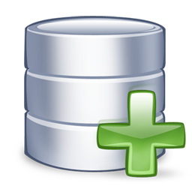
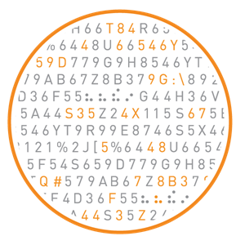
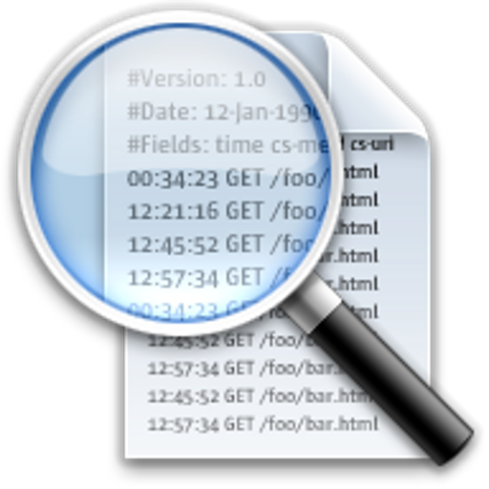


Streaming Analytics – A Paradigm Shift
Traditional Approach
Streaming Analytics
Historical Fact Finding
Analyze Persisted Data
Batch Philosophy
Pull Approach
On-Demand
Analyze the Current Moment “Now”
Analyze Data Directly “In Motion”
Analyze Data at Speed it is Created
Push Approach
Continuous Insights
Aggregate
Data
Analysis
Insight
Data
Store
Analysis
Insight
Raw
© 2020 IBM Corporation
Notes:
Context-aware stream computing is different from the traditional store-first-then-analyze paradigm – the left shows the traditional way data is accessed using queries to pull the data from a data storage device such as a data warehouse or database – which is still valid for many requirements.
The new context-aware stream computing paradigm brings data to the query – data is pushed or flows through the analytics.
Common drivers for those new use cases include:
When you need an immediate response/action and persisting and analyzing stored data isn’t fast enough.
When it is too expensive to store the data to be analyzed – for example, when most of it is throw-away and its more efficient to analyze/filter as you receive it and store the filtered results.

Slide 9
Streaming Analytics Application Pattern
Ingest
Prepare
Detect &
Predict
Decide
Act
Sensors
Social
Machine Data
Location
Audio
Video
Text
Transform
Filter
Correlate
Aggregate
Enrich
Classification
Patterns
Anomalies
Scoring
Events
Business Rules
Conditional Logic
Notify
Publish
Execute
Visualize
Store
Warehouse, Hadoop, Cloud Object Store, SQL, NoSQL Files
Ingest data from many sources & prepare it for analysis
  Transform, filter, correlate, aggregate and enrich the data for analysis
Detect & predict events and patterns in the data
Decide how the results should be handled and act on them
Store any data that is of longer term value
© 2020 IBM Corporation
Notes:
Streams is a development platform for limitless applications of real-time analytics, and you can program it to do just about anything. However, there is a universal pattern to how Streams applications are designed. And keep in mind that Streams always is just one element in a larger analytical architecture and must connect to multiple external systems to bring in data and send out results.
The Stream Computing application pattern is:
Ingest data from many sources & prepare it for analysis
Any kind of data: sensors, social, machine data, location, audio, video, text
Prepare: transform, filter, correlate, aggregate and enrich the data for analysis
Detect & predict events and patterns in the data
Classification, patterns, anomalies, scoring
Decide how the results should be handled and act on them
Business rules, conditional logic
Store any data that is of longer term value
Warehouse, Hadoop, operational store, files

Slide 10














IBM Streams acts on all your data in Real Time
Market leader in real time analytics
Machine Learning, Model Scoring, Geospatial, Video/Image, Text, Speech to Text, Predictive, Descriptive
Enterprise Ready
Visual development, Web console, Management via JMX, Enterprise connectors like Kafka, JSON, JMS, MQ, MQTT
© 2020 IBM Corporation

Slide 11


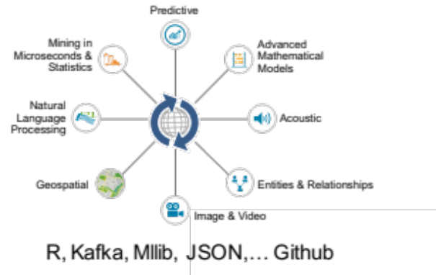
IBM Streams Key differentiators
Integrated Development Environment
Scale-Out Runtime
Analytic Toolkits
Agile and Manageable
Flexible and Scalable
Functional and Optimized
Ease of Use
  Performance monitoring
  Development environment with wizards, drag/drop development, performance dashboards, debugger
  No business disruption—Run, score & update models continuously
High Performance
  Millions of events/second
  Ultra-low latency clustered runtime
Built-In Streaming Analytics
© 2020 IBM Corporation

Slide 12
IBM Streams at a Glance
Out of the box with nearly 200 operators with 1300 functions
and dozens more in github.com/IBMStreams
Communications Data Sources
Internet (TCP/IP, UDP/IP, HTTP, FTP, RSS)
Messaging (Kafka, XMS, IBM MQ, Apache ActiveMQ, RabbitMQ, MQ TT, MQ Low Latency Messaging)
IBM DataStage
IBM Data Replication
Hadoop
Hadoop
HDFS, GPFS, Hive, Hbase, BigSQL, Parquet, Thrift, Avro
IBM Streams
Scale-out Runtime
RDBMS
IBM DB2, IBM DB2 Parallel writer, IBM Informix, IBM BigInsights BigSQL, IBM Netezza, IBM Netezza NZLoad, solidDB, Oracle, Microsoft SQL Server, MySQL, Teradata, Aster, HP Vertica
Data Warehouse
NoSQL
NoSQL
Key Value Stores (HyperState Accelerator, Memcached, Redis, Redis-Cluster, Aerospike)
Column Oriented Stores (Cassandra, Hbase)
Document Oriented Stores (IBM Cloudant, Mongo, Couchbase)
Primary Analytics
Application Development
Java
Scala
Python
Streams Processing Language (Drag & Drop)
Filter
Enrich
Normalize
Windowed Aggregations
Machine Learning
Scoring (SPSS, Python, R, MLlib)
Signal Processing
CEP & Pattern Matching
Geospatial
Video/Image
Text Analytics (AQL)
Speech to Text
Rules
Deep Packet Inspection
© 2020 IBM Corporation
© 2018 IBM Corporation

Slide 13







Ready for the Internet of Things
Streams support ,
and Websockets
    Favored messaging platforms for IoT
IoT toolkit combines required components
    Receive events, send commands
    JSON parsing and construction
    Device management
Integrates with Watson IoT Platform,
MessageHub
    Bluemix
Streams Studio supports
    Streaming analytics on edge devices
© 2020 IBM Corporation

Slide 14

Ready for the Data Lake
Streams integrates with the IBM Information Governance Catalog
  Streams Studio support
Asset discovery
  Find data sources registered
  in the Governance Catalog
  Drag and drop in graphical editor
  to generate source operators
Asset registration
  Streams jobs and sinks (output) fully governed
Data lineage
  Streams transformations shown like any other asset flow
© 2020 IBM Corporation
Notes:
A data lake is a well managed repository of data assets and processes that are tracked and catalogued for purposes of discovery and analysis. Streams Studio integrates with a key component of IBM’s data lake offering: the Information Governance Catalog (IGC).
This integration takes two forms. First, in the graphical editor you can drag catalogued data sources such as database tables directly into your application graph; the editor automatically configures the required source operator, complete with the right connection and access configuration.
Second, the output of a Streams job can be catalogued to become a managed asset like any other. In the IGC, data transformations applied by Streams jobs are fully represented in the lineage of a data asset.
© 2017 IBM Corporation

Slide 15










IBM Streams addresses industry challenges
 | Telecommunications Call center agent assist CDR processing Network monitoring Next best action Geospatial analytics |  | Law Enforcement, Defense and Cyber Security Real-time multimodal surveillance Situational awareness Cyber security detection Data Leakage
 | Transportation Intelligent traffic management Automotive telematics Trend Detection |  | Finance and Banking Impact of weather on securities prices Analyze market data at ultra-low latencies Marketing next best action Regulatory monitoring and Audits
 | Energy & Utilities Network monitoring Transactive control Phasor Monitoring Unit Down hole sensor monitoring |  | Insurance and Fraud prevention Detecting multi-party fraud Real time fraud prevention Know your customer (360) Next best action
 | Health & Life Sciences ICU patient monitoring Epidemic early warning system Remote healthcare monitoring Transcription Services |  | e-Science Space weather prediction Detection of transient events Synchrotron atomic research Genomic Research
 | Natural Systems Wildfire management Water management |  | Cross industry Call center agent assist Social and news text analysis Intelligent Ingest
© 2020 IBM Corporation

Slide 16
Hands on Lab
© 2020 IBM Corporation
Notes:
This deck is intended to provide a technical sales specialist (TSS) all the material need to cover IBM Streams from elementary (explaining stream computing and why it’s important) to a deeper dive in the Streams paradigm and specific features. It tries to provide a justification for each of the features discussed (answering the “so what?” question).
Do not attempt to present this deck in its entirety to a customer. Pick and choose the slides that are relevant to the customer’s industry and possible use cases, and fit your selection in the time allotted.

Slide 17
© 2020 IBM Corporation

